Slide 1
Lake Michigan Water Levels Forecasting

Slide 2
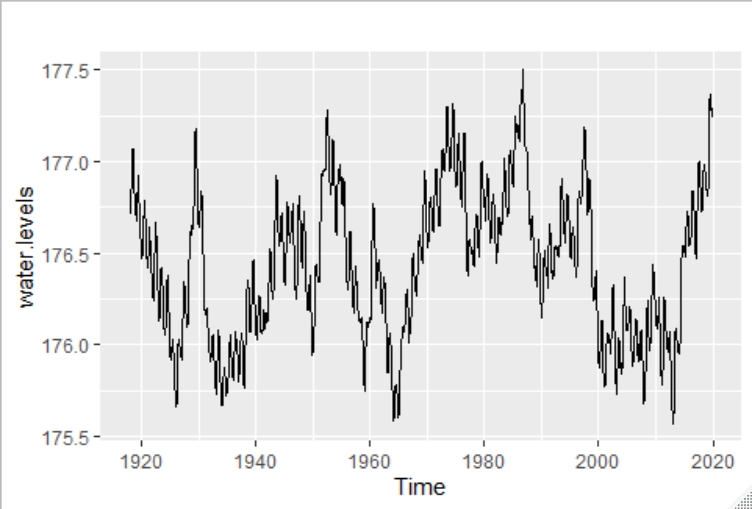
Overview
Rising Lake Michigan water levels are causing infrastructure problems from Wisconsin to Michigan. We will attempt to forecast the rise to help city planners figure out how to address the problem and plan for the future.

Slide 3

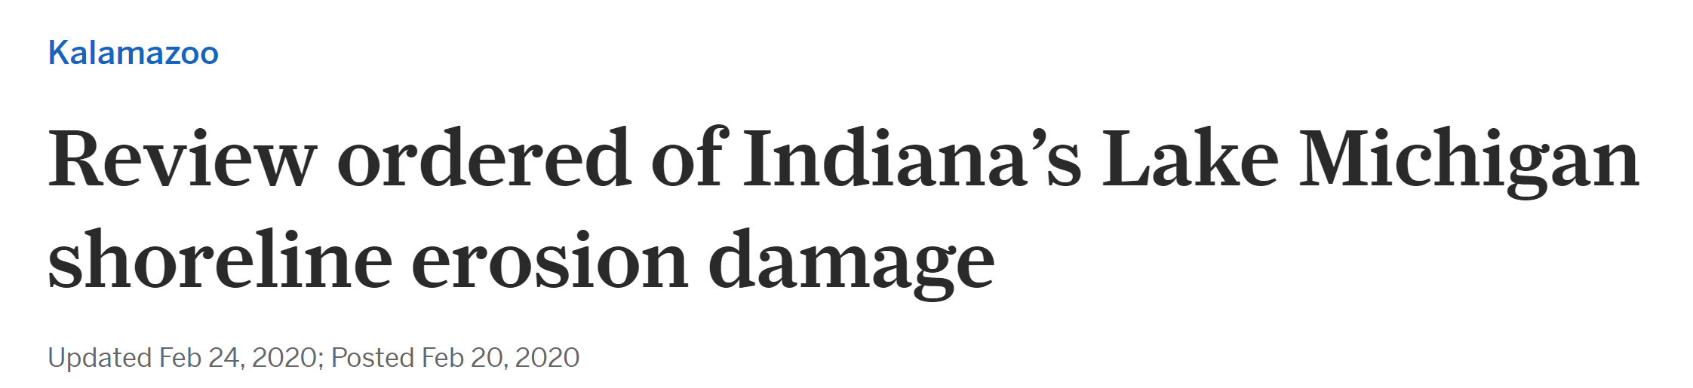
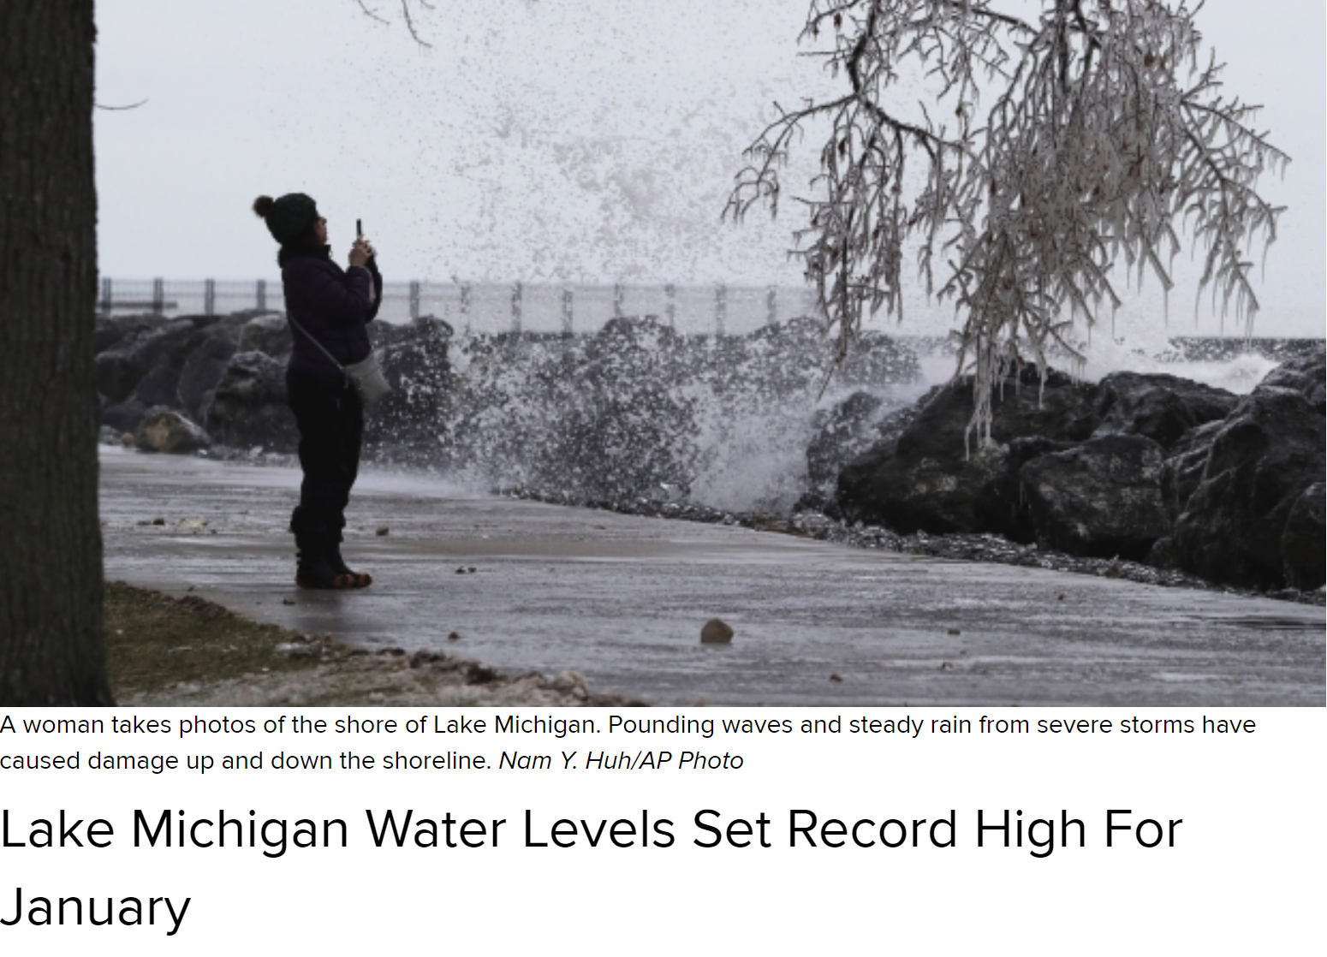
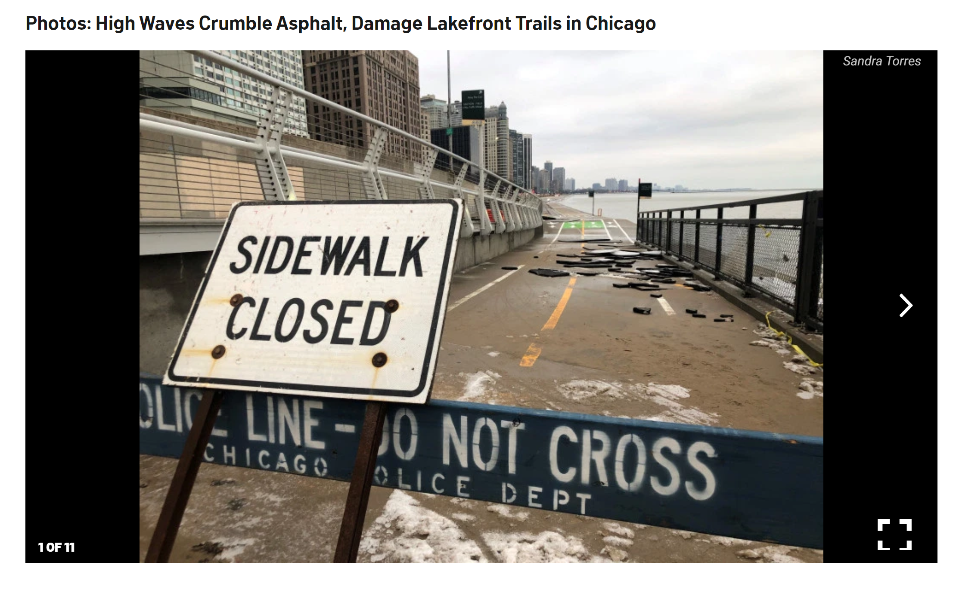

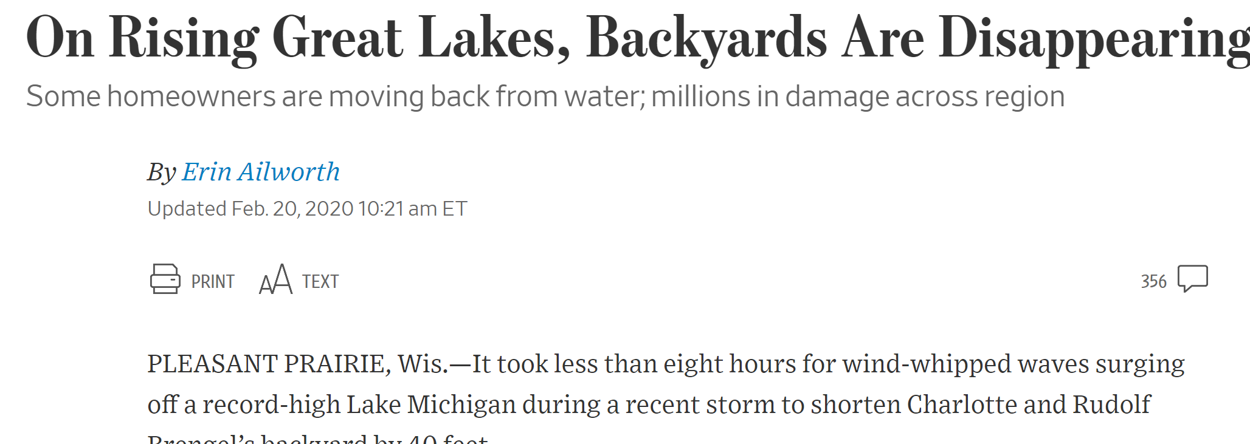
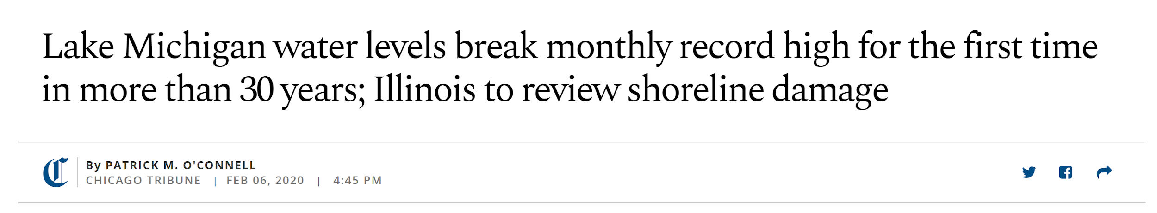
Overview

Slide 4
Team Members
Nazarat Hossain
nazarat hossain
Nikhil Chaturvedi
Carmin Ballou
Regression/VARS Modeler
Code Editor
Holt-Winters/TBATSModeler
Code Compiler
ARIMA/Arfima Modeler
Presentation Prep

Slide 5
Data
Lake Michigan-Huron Water Levels
Collected by National Oceanic and Atmospheric Administration (NOAA) monthly since 1918.
Regression (Local):
Overlake Precipitation (NOAA)
Overland Precipitation (NOAA)
Surface Air Temperature (NOAA)
Overland Temperature (NOAA)
Regression (Global):
Land/Ocean Temperature (NASA)
Sea Level Rise (EPA)
Data Format:
Different data ranges presented challenges: data was presented as daily, monthly or hourly.

Slide 6
Lake Michigan Water Levels: 1918-2019

Slide 7
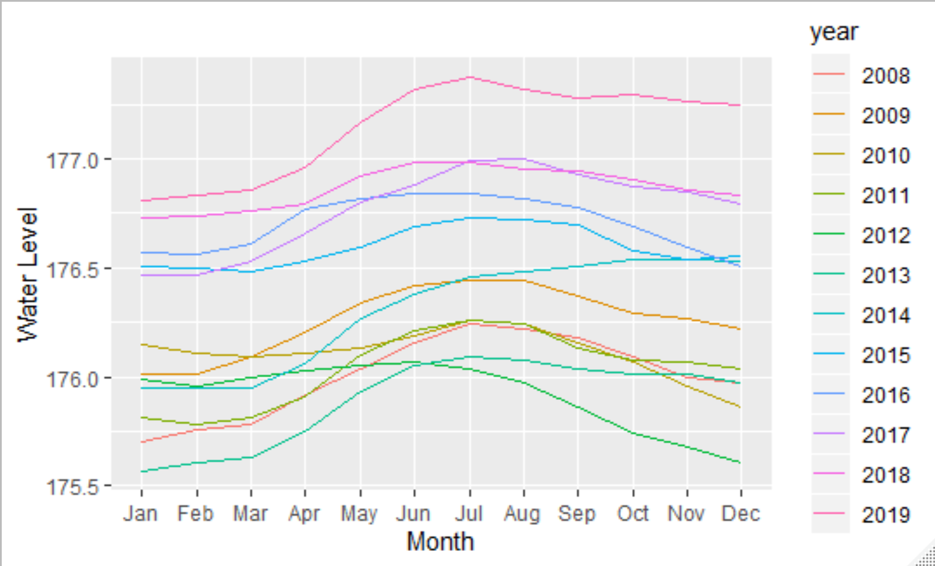
Seasonality Patterns: 2008-2019

Slide 8
Arima

Slide 9
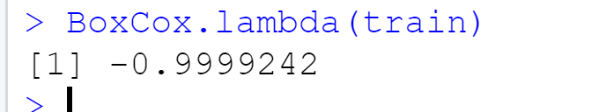
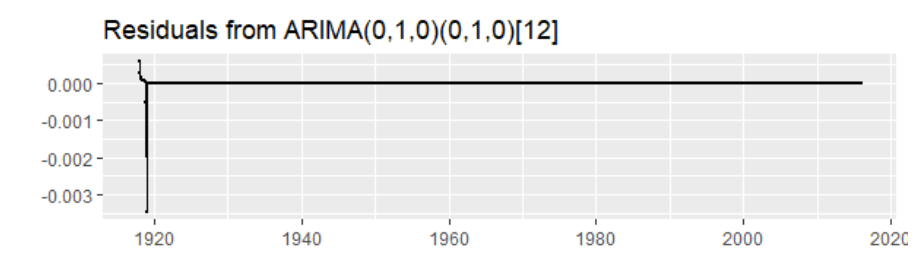
Arima
Increasing Variance Made Box Cox Appropriate:
White Noise with Lambda performed better than auto.arima, but didn’t capture seasonality.
Seasonal random trend was the best model with -log (0,1,0; (0,1,0)

Slide 10
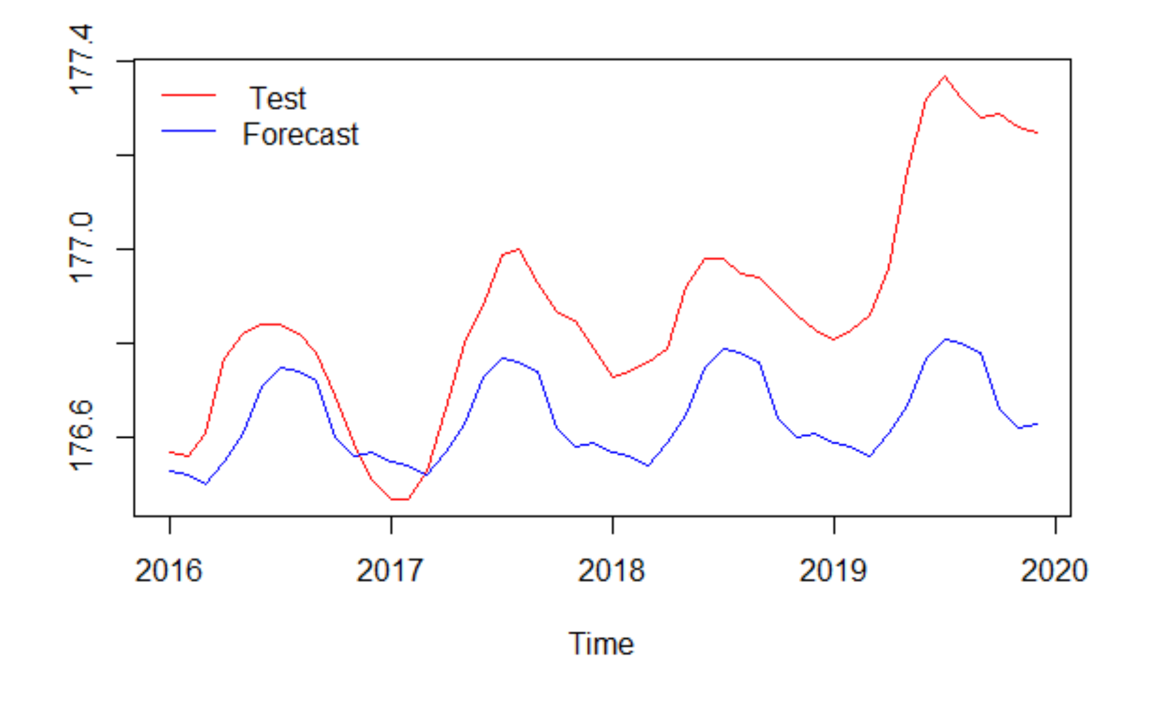
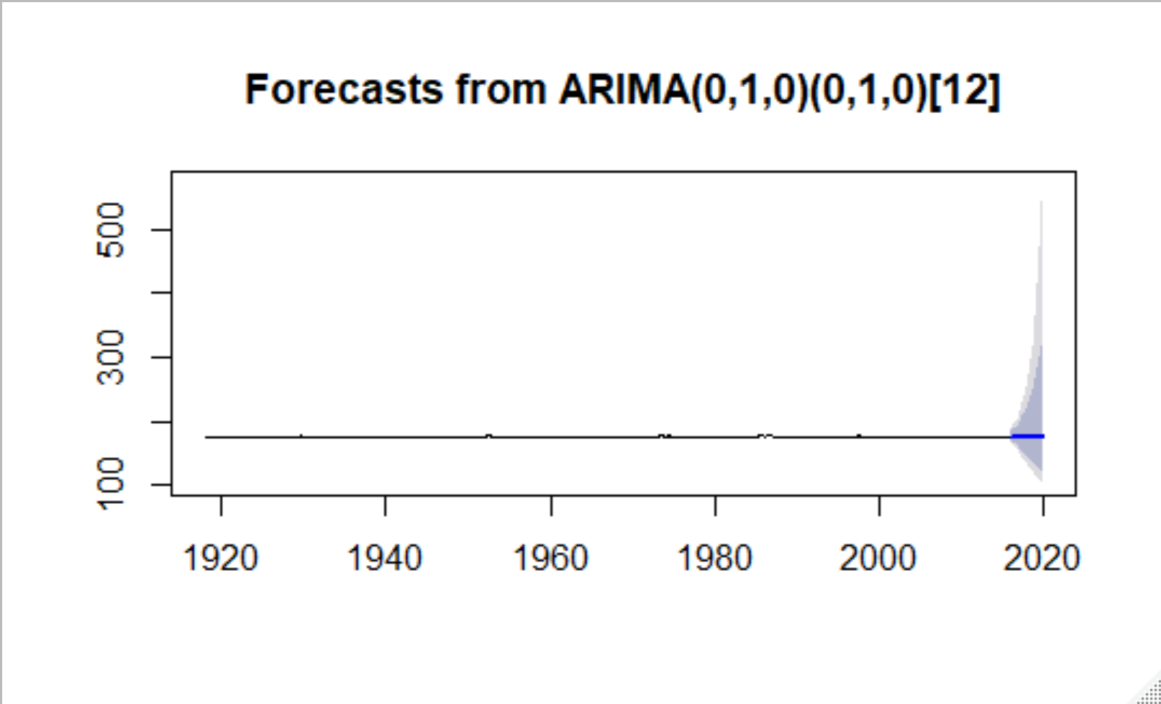
Arima: Forecasts
Resulted in a narrower confidence ResulteResultinterval:
Seasonal patterns continued for test data
Very wide confidence intervals

Slide 11
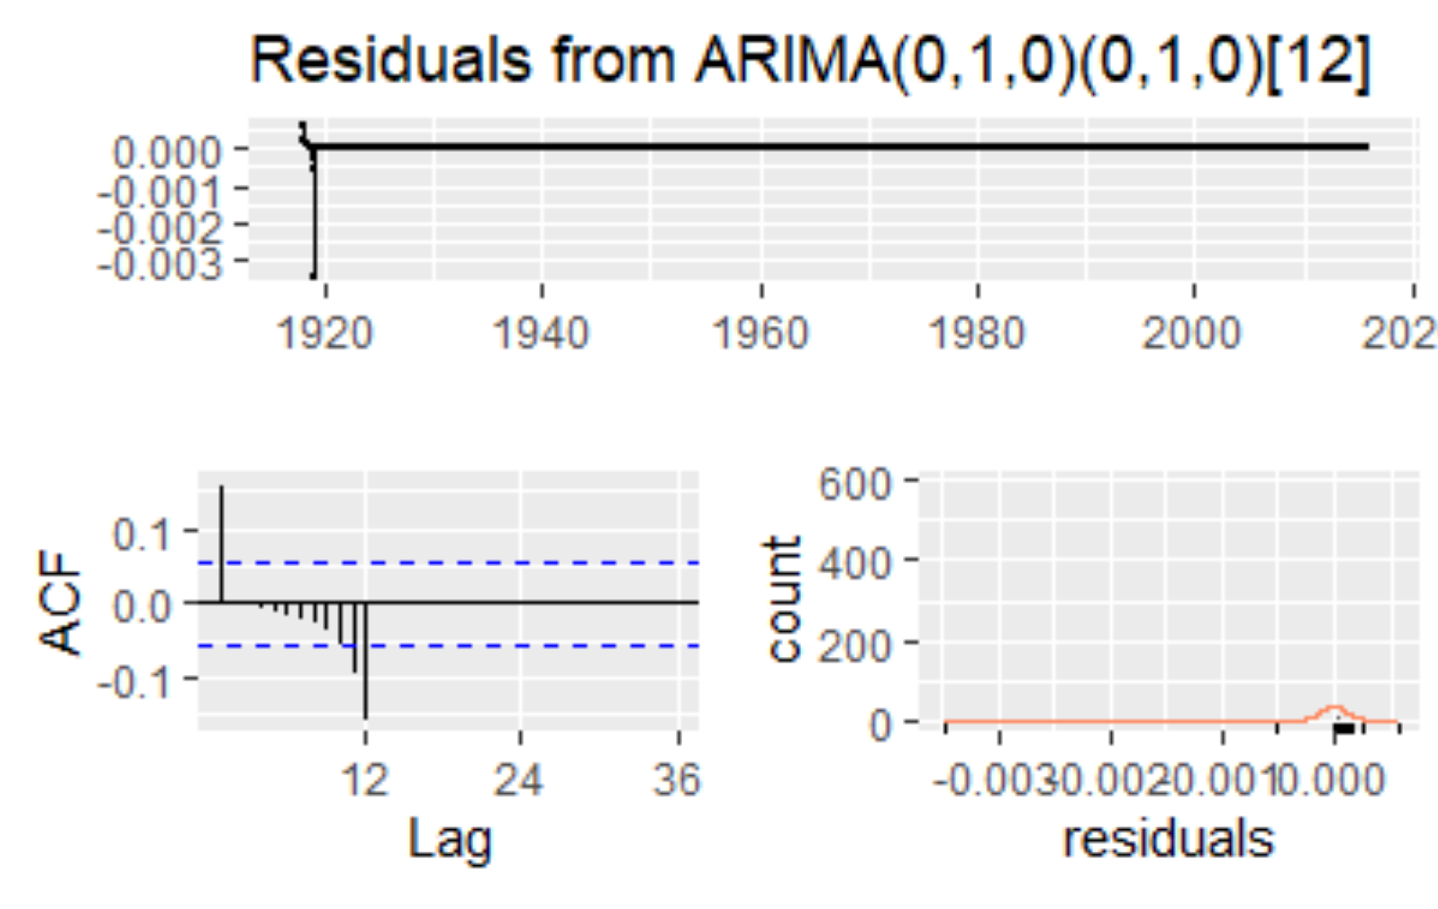
Arima: Residual Analysis
Resulted in a narrower confidence ResulteResultinterval:
Not great:
Overfitting
Lag ACF values

Slide 12
Arima: Summary
What Worked:
Relying on differencing resulted in best AICc..
Negative Log transformation made it precise, but likely overfit..
What Didn’t:
Auto.arima created even more complicated models than necessary.
Even a simple model may have resulted in overfit.
Confidence intervals are giant the further out from present because a key component is basically a random walk.

Slide 13
Exponential Smoothing

Slide 14
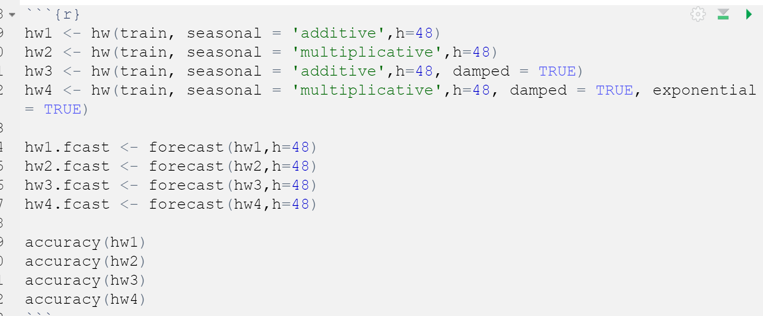
Exponential Smoothing
Attempted exponential smoothing as it seemed likely that using weighted averages might improve performance over Arima.
Used Holt-Winters as we needed to account for trend and seasonality.
Used MAE as the basis for selection.

Slide 15
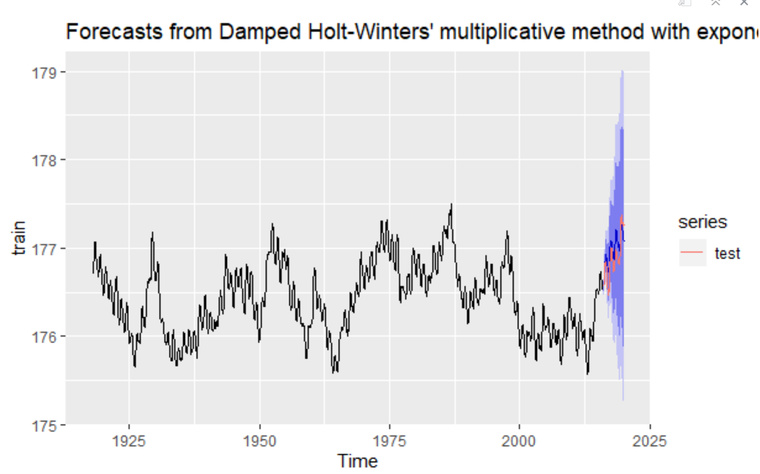
Exponential Smoothing: Forecasts
Resulted in a narrower confidence ResulteResultinterval:
Selected Holt-Winters:
Damped
Multiplicative
Exponential
Resulted in narrower confidence intervals than Arima.

Slide 16
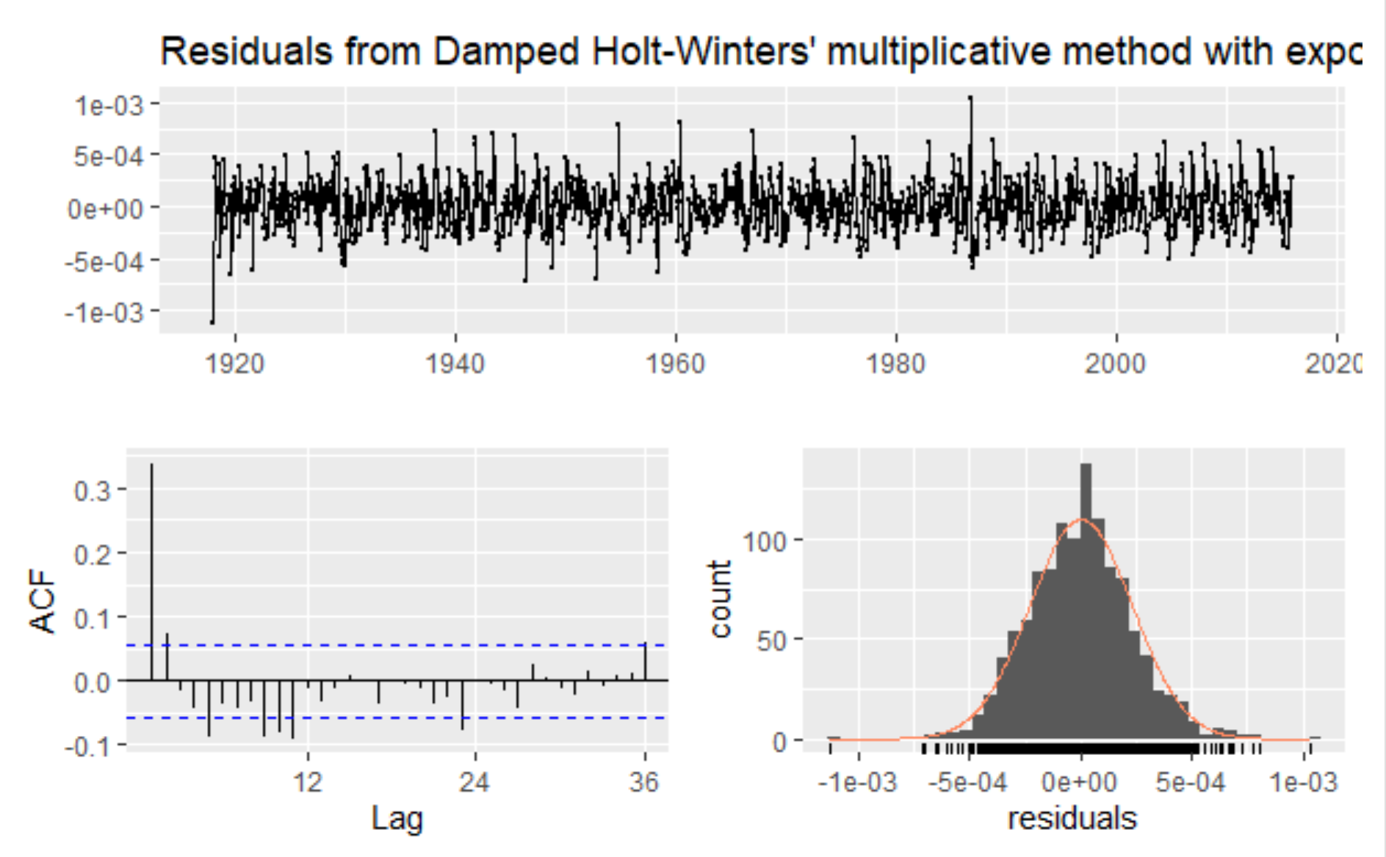
Exponential Smoothing: Residual Analysis
Resulted in a narrower confidence ResulteResultinterval:
Residuals, to the eye, looked like white noise.
But Ljung-Box and aCF graph showed there was still autocorrelation present

Slide 17
Exponential Smoothing: Residual Analysis
What Worked:
Better confidence intervals than arima.
Correctly forecasted results in test data set.
What Didn’t:
Long-term forecasting still has a wide confidence interval which could present a problem for long-term infrastructure planning.
Damped=True was counter-intuitive

Slide 18
Regression Analysis

Slide 19
Regression Analysis
Given the lack of precision with Arima and Exponential Smoothing, we turned to regression hoping to explain the cyclical pattern.

Slide 20
Regression Analysis
Data Sets Analyzed:
Global:
Land/Ocean Temperature (NASA)
Sea Level Rise (EPA)
Local:
Overlake Precipitation (NOAA)
Overland Precipitation (NOAA)
Overlake Air Temperature (NOAA)
Overland Temperature (NOAA)

Slide 21
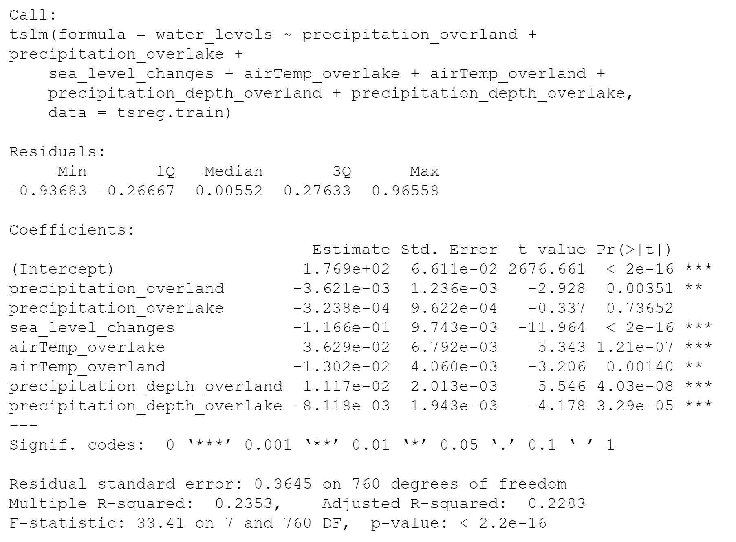
Regression Analysis: Time Series Linear Model
Started with ordinary time series linear model:

Slide 22
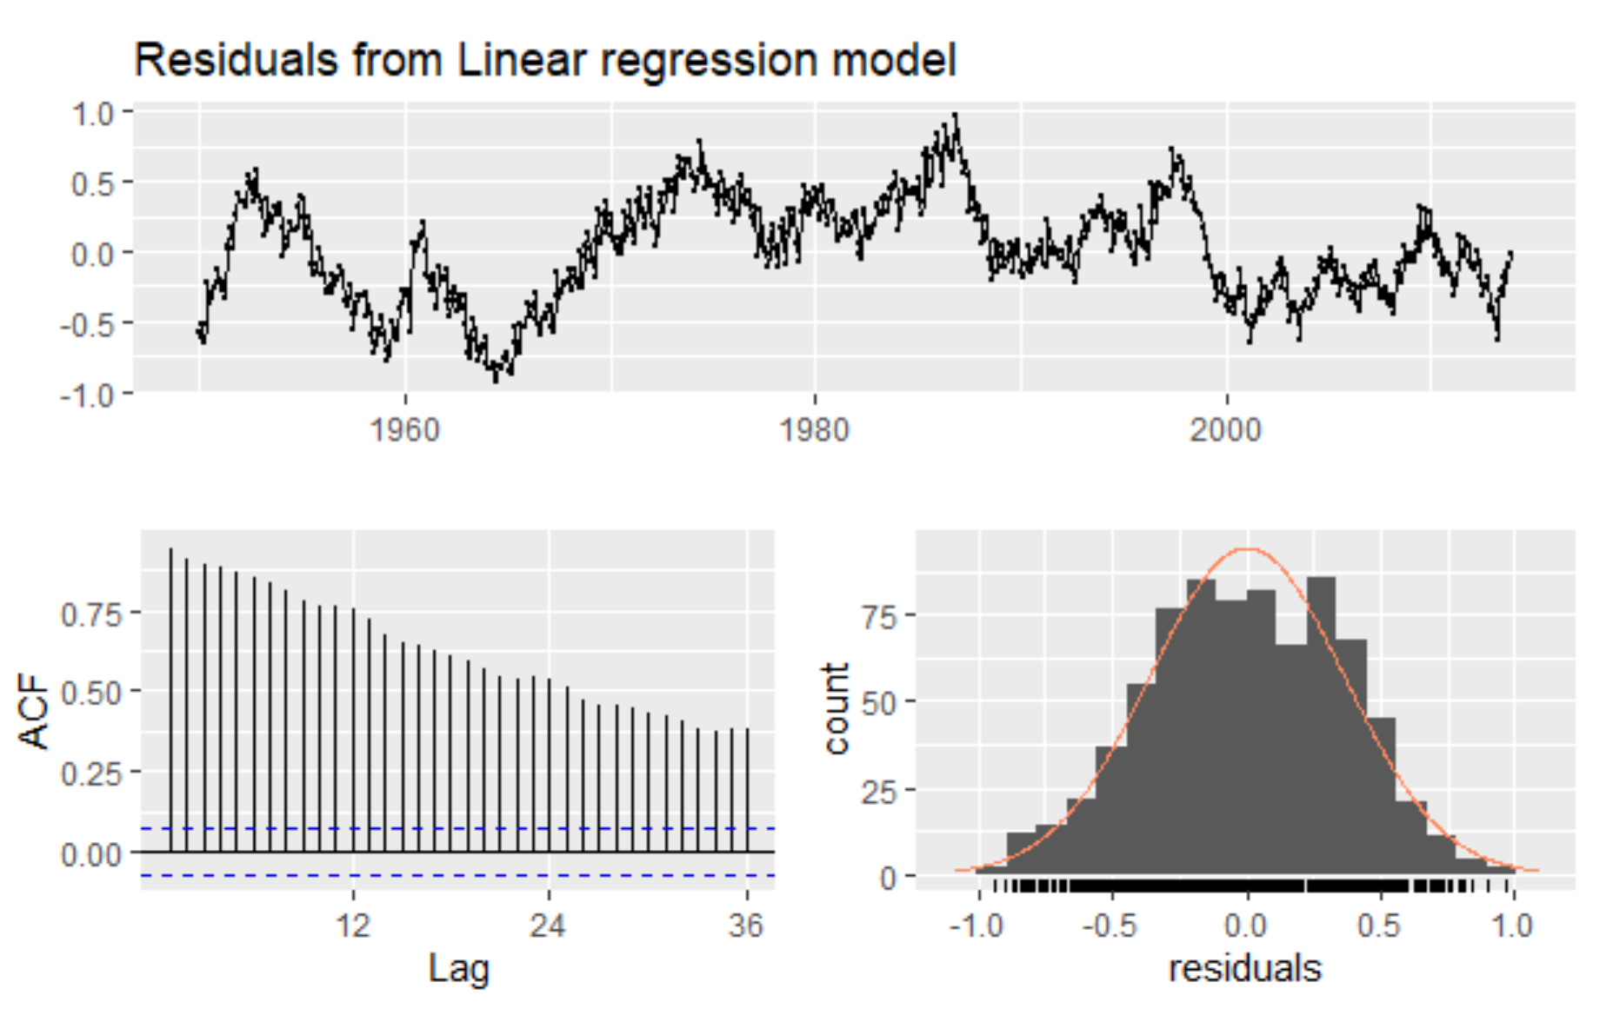
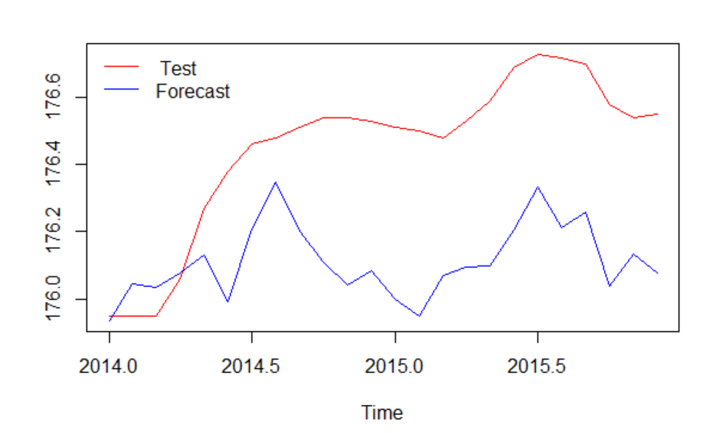
Regression Analysis: TSLM Results
Residuals are not white noise
Autocorrelation is present

Slide 23
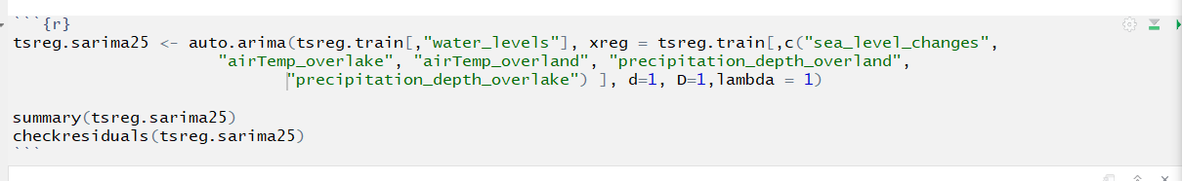
Regression Analysis: Regression with Arima errors
Tried numerous arima options and ultimately selected:

Slide 24
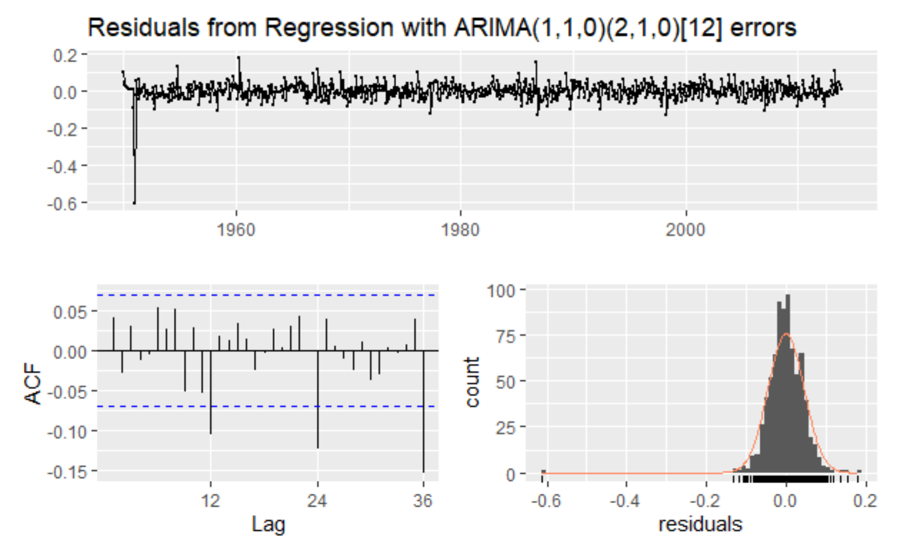
Regression Analysis: Regression with Arima errors-Residual
Resulted in a narrower confidence ResulteResultinterval:
Looks closer to white noise
Some lingering autocorrelation around the 12-month mark that we were never able to address

Slide 25
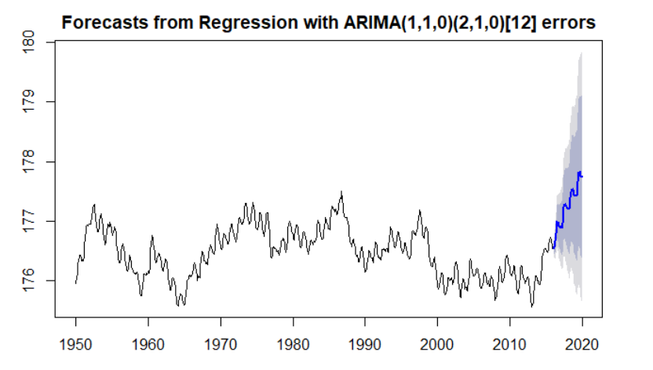
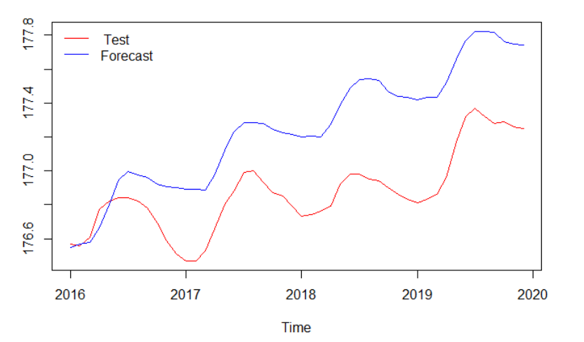
Regression Analysis: Regression with Arima errors-Forecast
Resulted in a narrower confidence ResulteResultinterval:

Slide 26
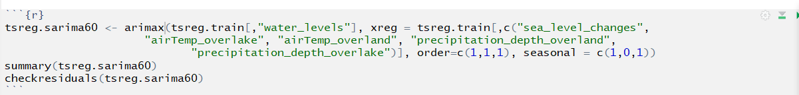
Regression Analysis: Arimax
Arimax: Wanted to use predictor variables with ARMA factors.

Slide 27
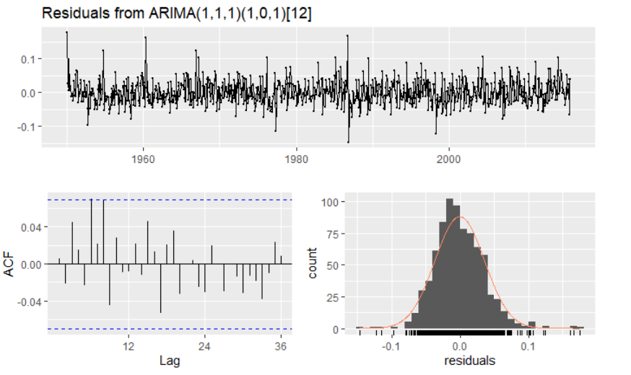
Regression Analysis: Arimax-Residual
Resulted in a narrower confidence ResulteResultinterval:
Residuals:
White noise
Nice distribution
ACF is good

Slide 28
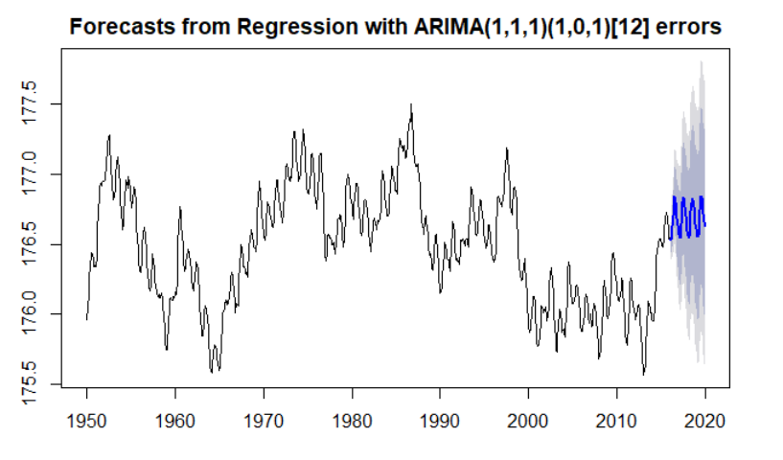
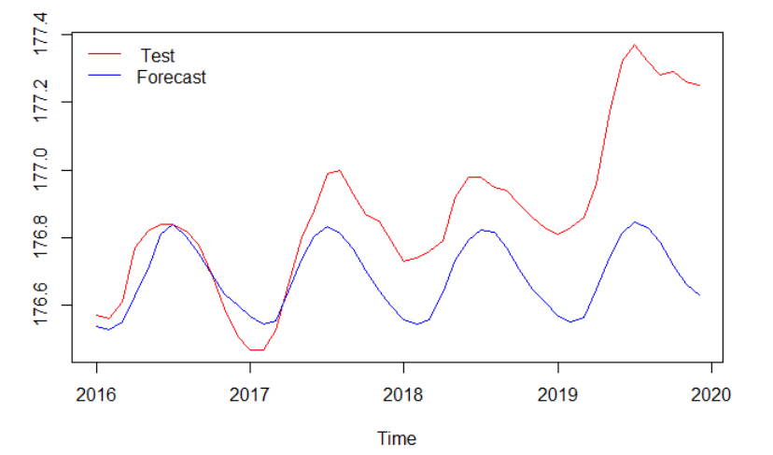
Regression Analysis: Arimax-Forecast
Resulted in a narrower confidence ResulteResultinterval:
Narrower confidence intervals

Slide 29
Regression Analysis: Summary
What Worked:
Model:
Arimax
The Data:
There were lots of interesting data sets to work with.
What Didn’t:
Models:
TSLM
Auto Arima with xreg
Arimax forecasting.

Slide 30
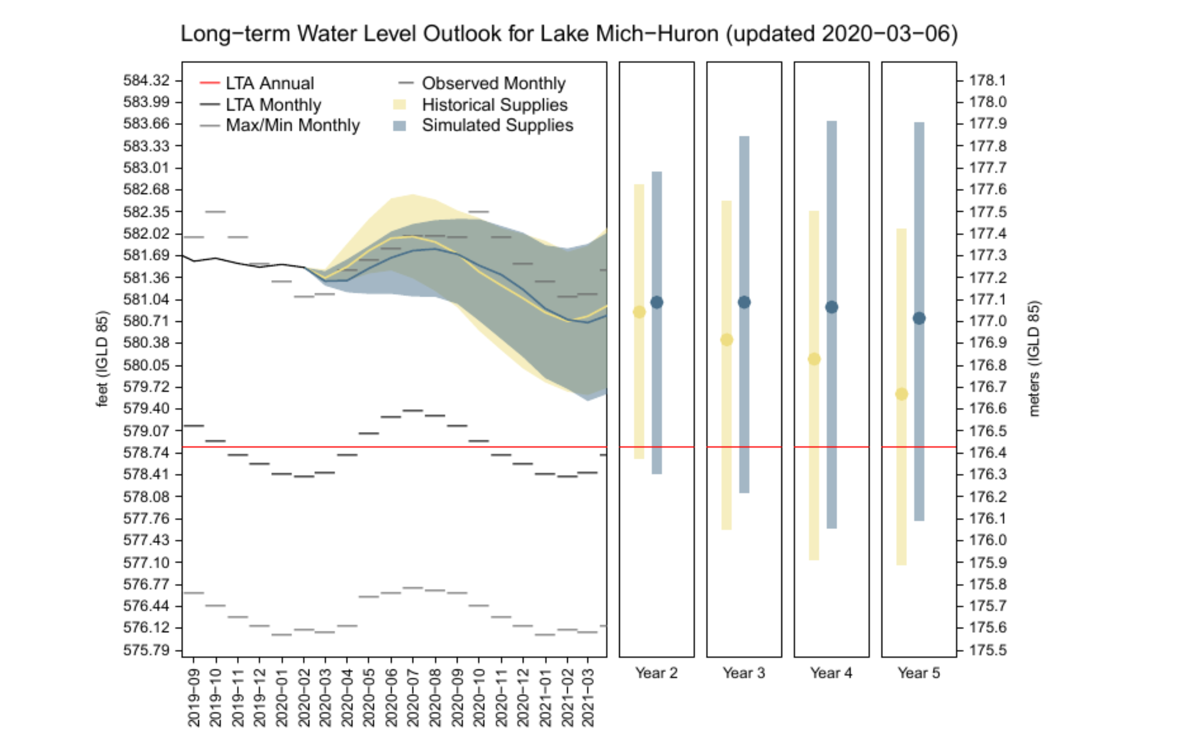
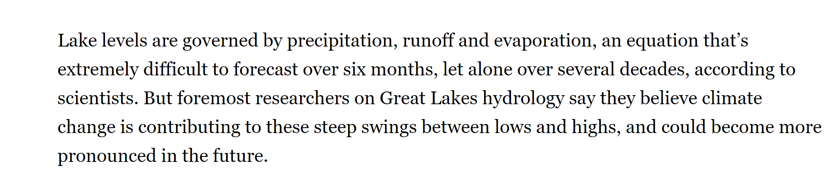
Conclusion:
Difficult to predict
Experts also analyze:
Global climate patterns
Human usage

Slide 31

Next Steps:
Depave the drive?
Consider Neural Networks for More analysis

